Slide 1
Advanced Techniques for Preprocessing of Text/Data
_{Prepared by: Shahbaz Ali}
29/05/2024

Slide 2

Overview
Text preprocessing is a critical step in natural language processing that involves cleaning and preparing text data for analysis or machine learning models
spaCy and NLTK are two popular Python libraries used for text preprocessing

Slide 3

Tokenization
spaCy
Provides efficient, pre-trained models for tokenization
Handles complex languages and different scripts robustly
Supports multi-language tokenization and custom tokenization rules
NLTK
Offers a variety of tokenization methods like word tokenizers and sentence tokenizers
Includes customizable regex-based tokenization
Suitable for academic research and teaching due to its simplicity

Slide 4

Part-of-Speech Tagging
spaCy
Utilizes neural network models for accurate POS tagging
Pre-trained models available for multiple languages
NLTK
Users can train custom POS
Offers detailed tagsets for linguistic research

Slide 5
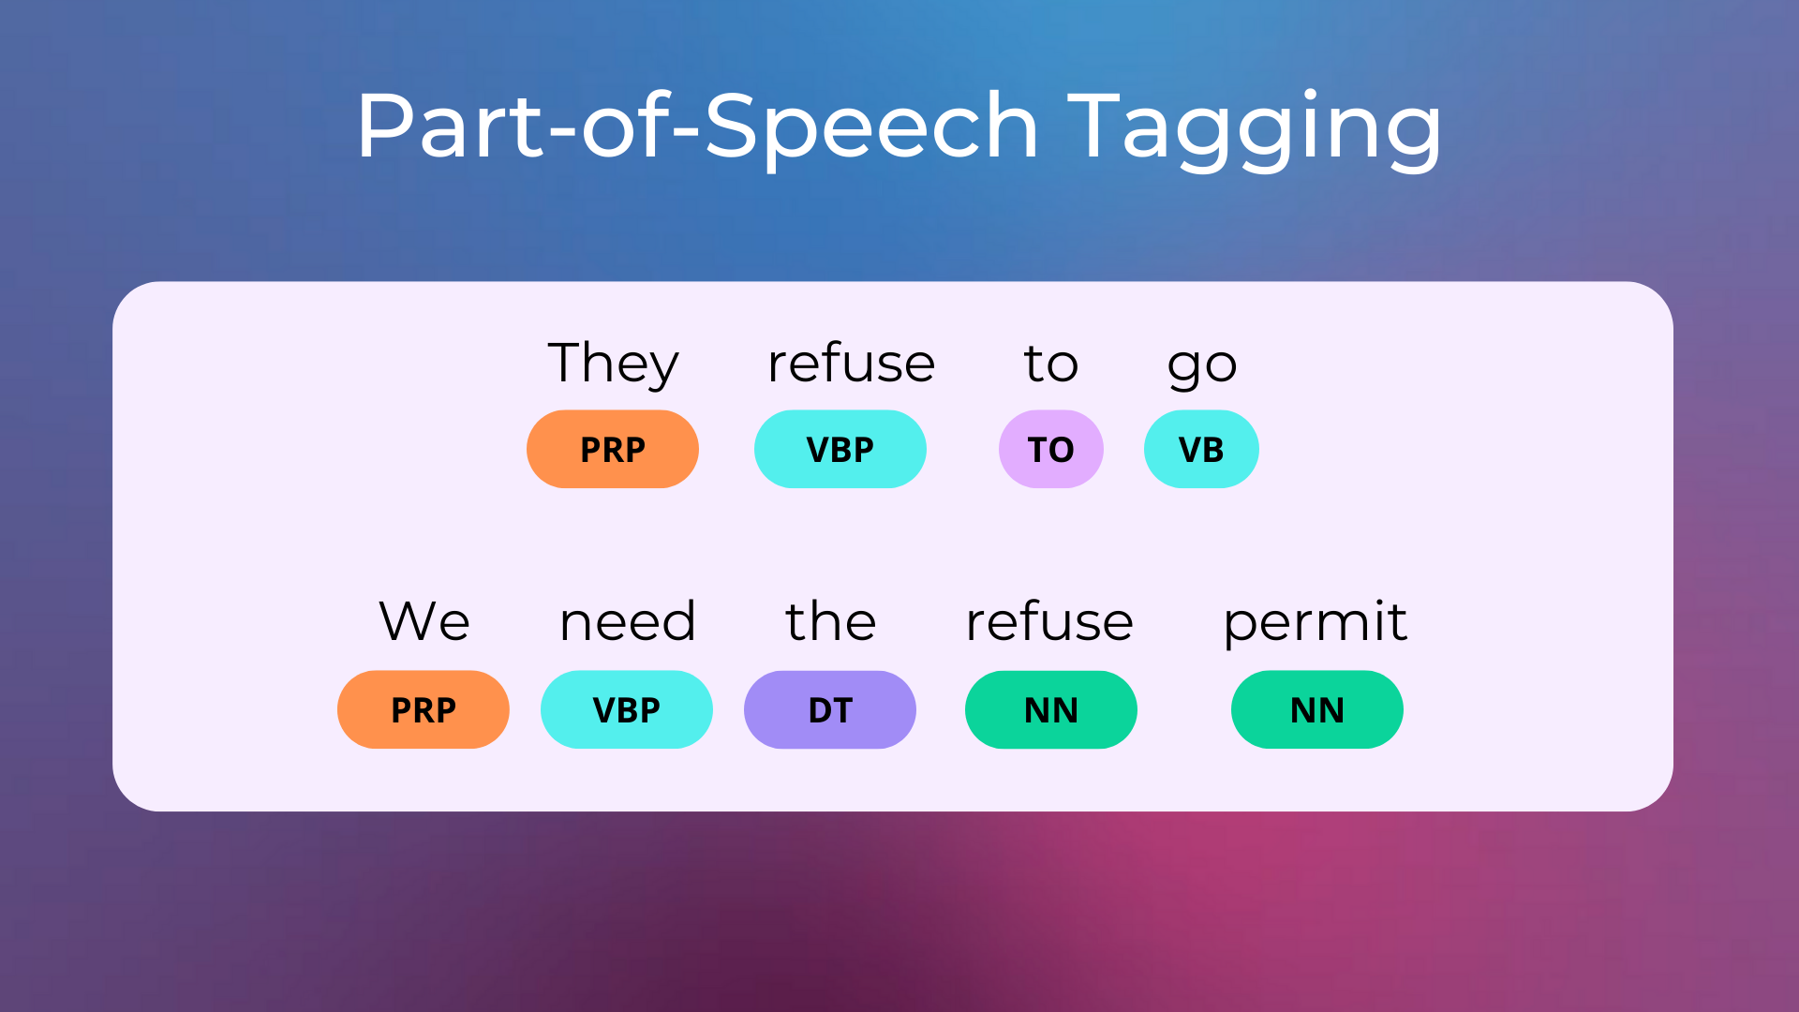

Slide 6

Named Entity Recognition
spaCy
Advanced NER capabilities with pre-trained models for multiple languages
Efficient and scalable for large datasets
NLTK
Basic NER functionality through the ne_chunk module
Suitable for simple entity recognition tasks

Slide 7
Stemming and Lemmatization
Stemming is the process of reducing a word to its base or root form, typically by removing suffixes. The resulting stemmed word may not be a valid word in the language.
Lemmatization takes into account the part of speech of the word, which leads to more accurate results compared to stemming.

Slide 8
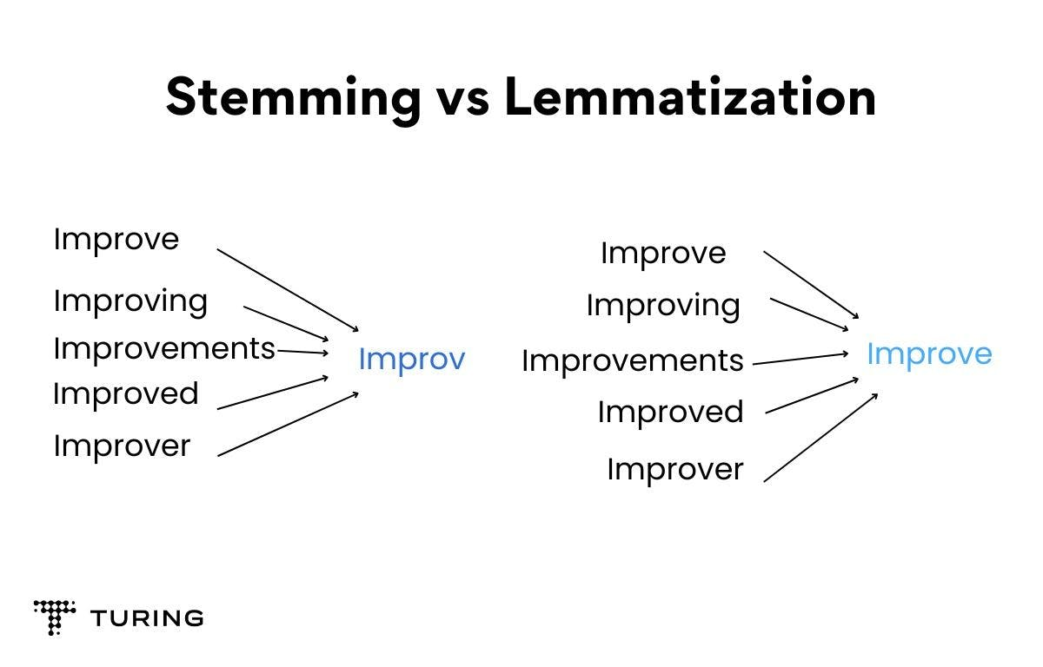

Slide 9
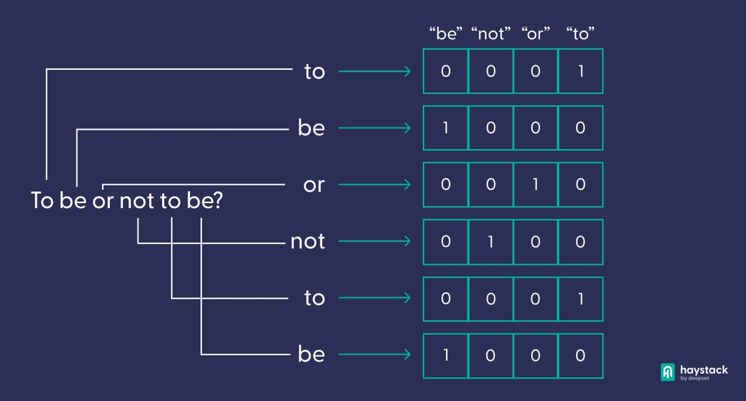
Vectorization
Vectorization in AI, particularly in natural language processing (NLP) and machine learning, refers to the process of converting textual data (such as words, sentences, and documents) into numerical vectors.

Slide 10
Speed and Performance
spaCy
Optimized for performance, ensuring faster processing times
Suitable for real-time applications and large datasets
NLTK
Pure Python implementation, which can be slower
Better suited for prototyping, education, and small-scale projects

Slide 11

Community and Ecosystem
spaCy
Strong industry support and active community contributions
Regular updates and extensive tutorials
NLTK
Long-standing tool with a large base of academic users
Extensive resources for teaching and learning NLP

